Slide 1


Slide 2
Why Windows Presentation Foundation?

Slide 3
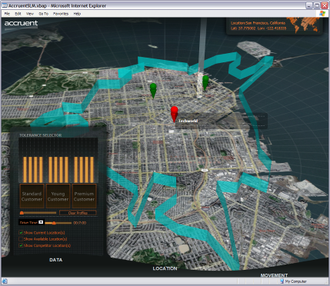
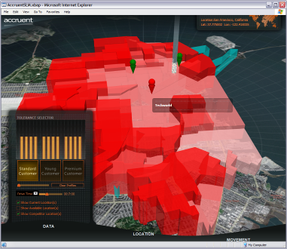
Windows Presentation Foundation
Unified approach to UI, Documents, and Media
Integration as part of development and experience
Integrated, vector-based composition engine
Utilizing the power of the PC throughout the graphics stack
Declarative programming
Bringing designers directly into application development
Ease of deployment
Allowing administrators to deploy and manage applications securely
Notes:
Context: These are the four goals of WPF – next few slides drill down further on each of them.
Building UI, graphics, documents and media into a single environment: providing a richer experience by unifying these together, allowing them to be integrated in a far deeper way than before, and reducing the number of APIs developers have to track by putting things into a single managed object-orientated interface.
Rich graphics processors woefully underused by modern applications. 128MB memory, rich 3D capabilities. Avalon takes advantage of these capabilities using a DirectX-based model. Vector- rather than bitmap-based, supports high-dpi, double buffering.
Declarative and procedural programming supported for designers and developers to do what they want to do.
Need to make it as easy as “clicking on a link” to deploy an Avalon application: either via a browser or via a standalone app.

Slide 4
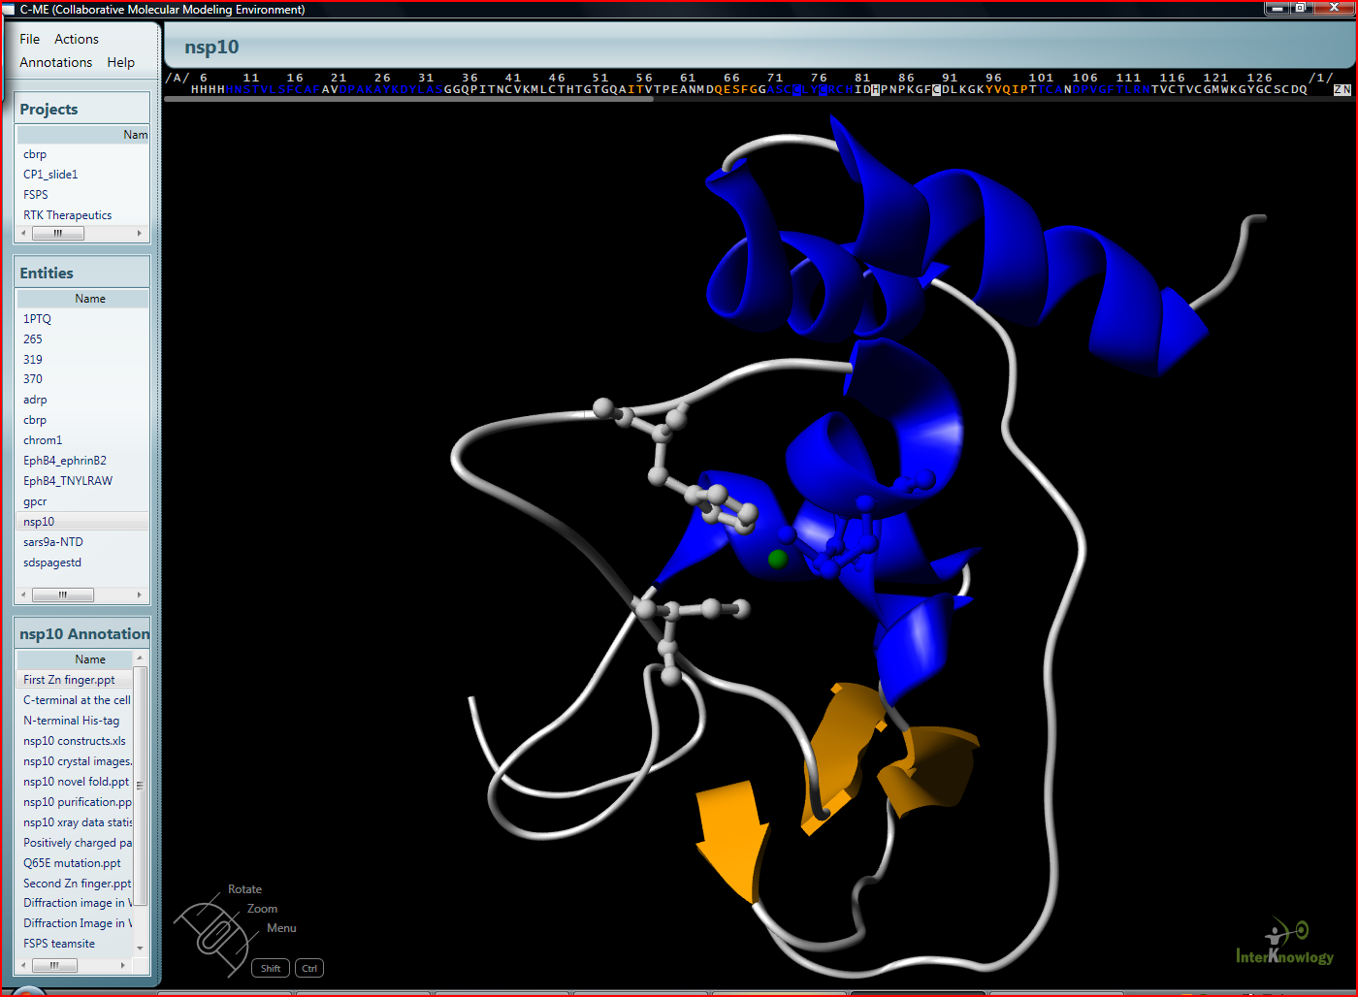
Scripps Healthcare
Allowing cancer researchers to collaborate in the search for a cure

Slide 5
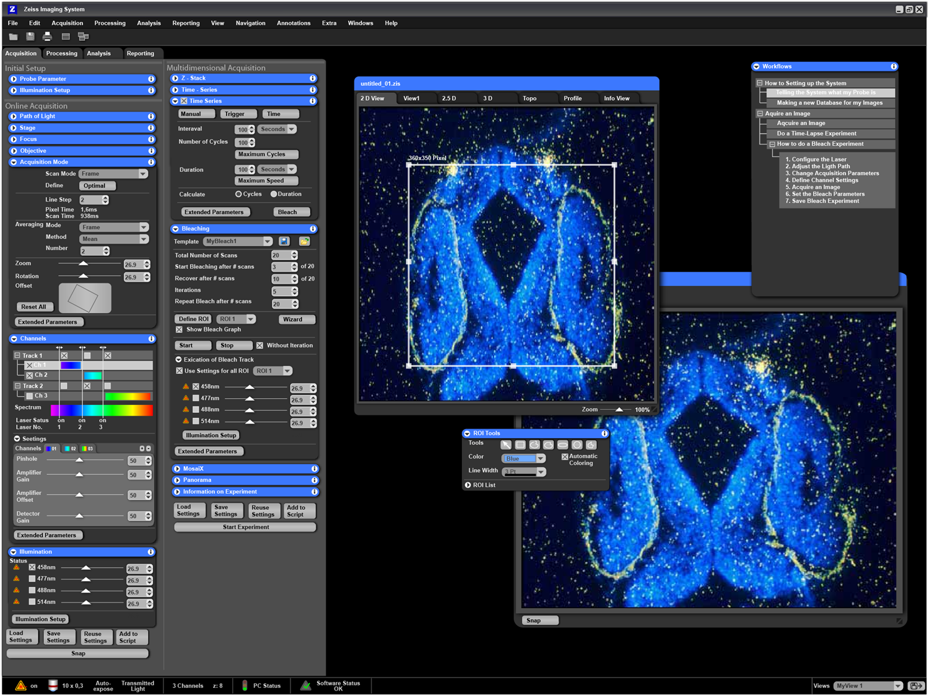
Carl Zeiss
Medical imaging analysis

Slide 6
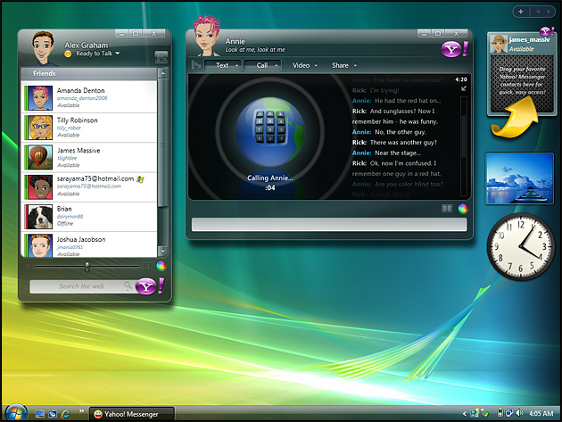
Yahoo
Next-generation instant messaging client

Slide 7
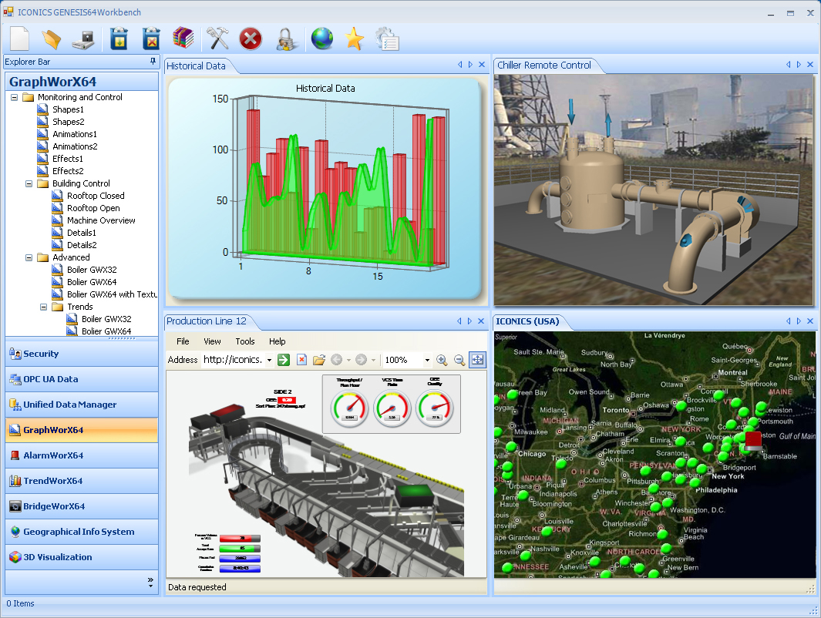
Iconics
Real-time manufacturing visualizations

Slide 8
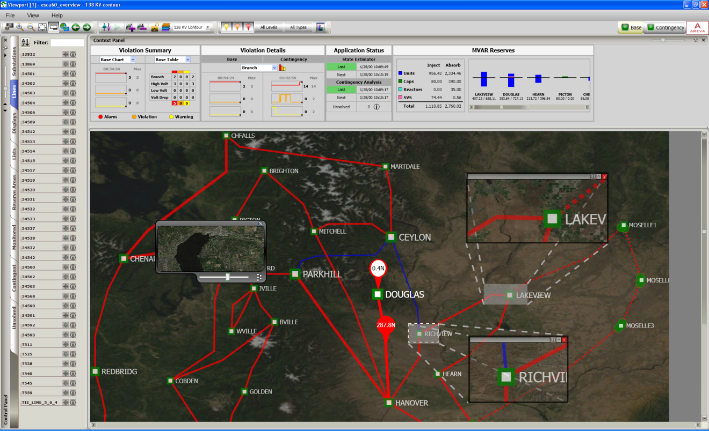
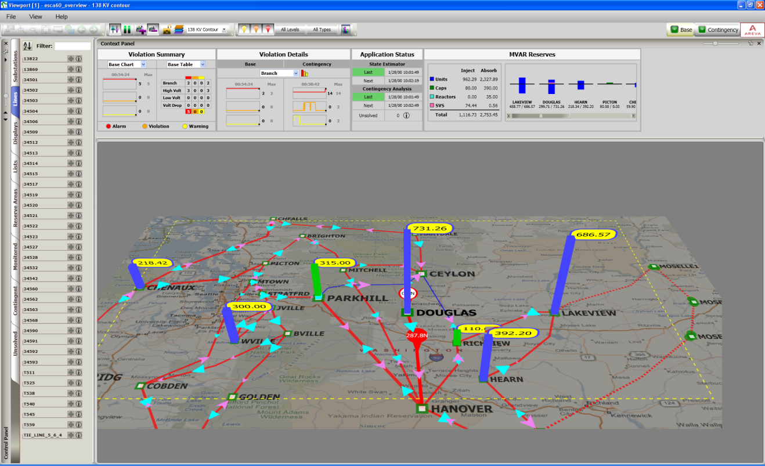
Areva
Monitoring and controlling the electricity power grid

Slide 9
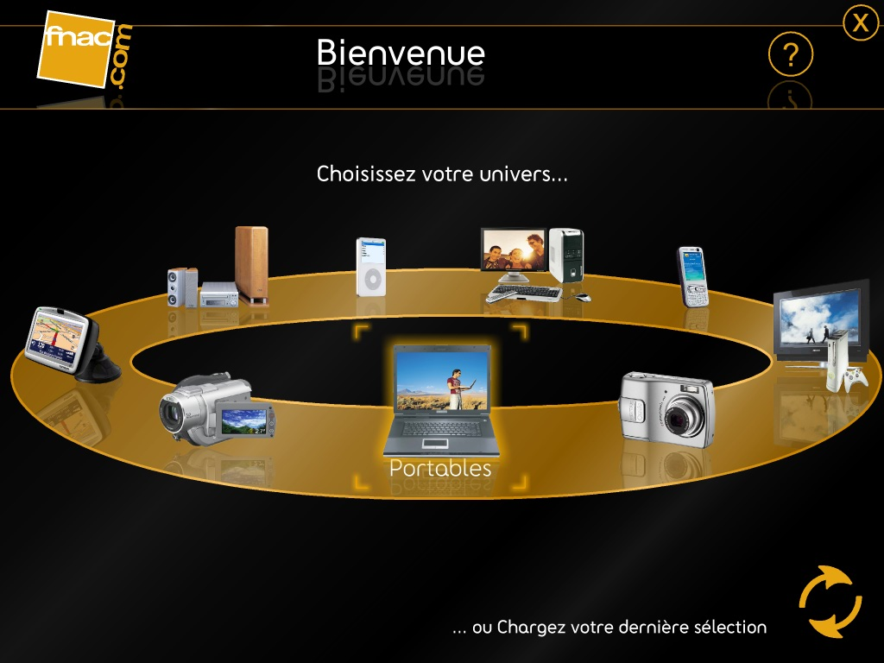
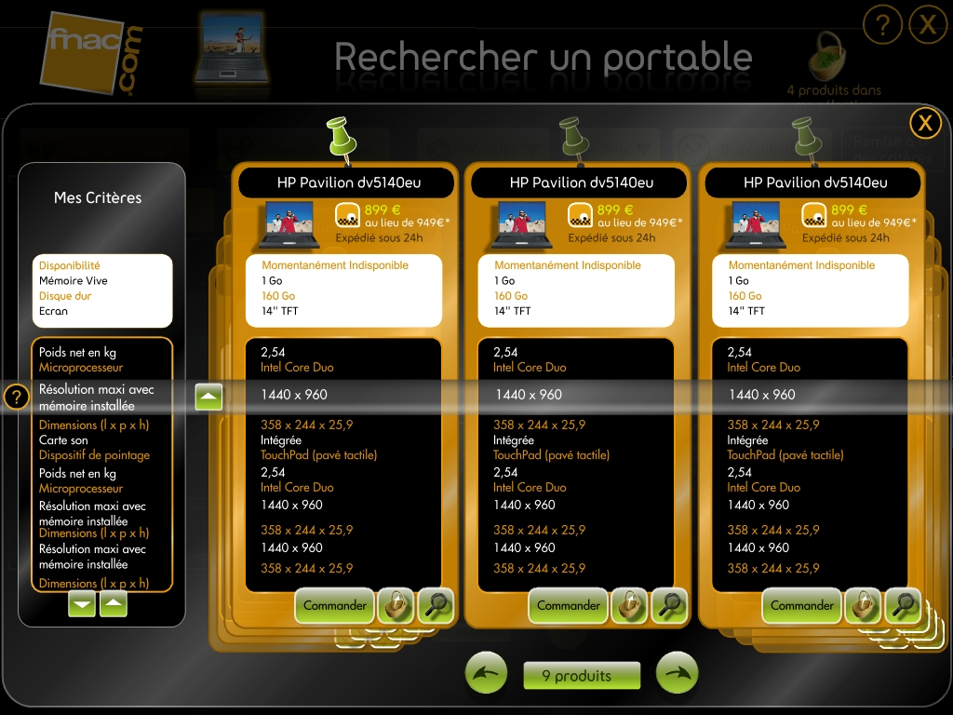
fnac.com
French Technology Retailer

Slide 10
WPF Technical Overview

Slide 11
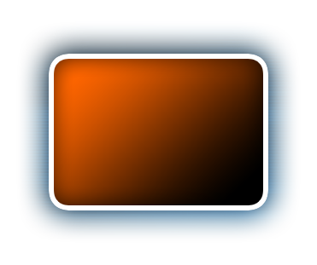
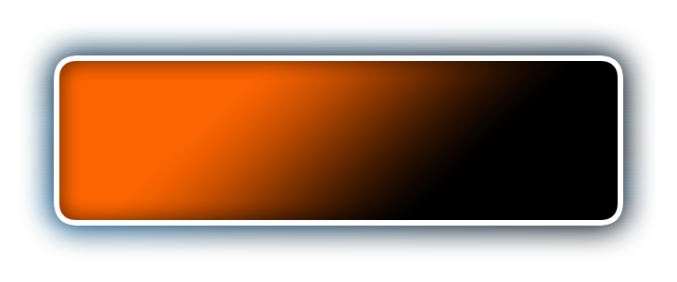




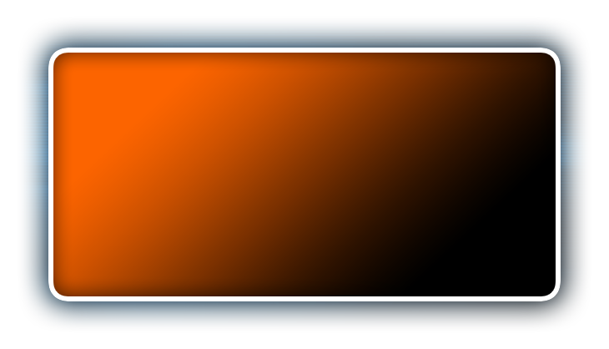













Document Services
User Interface Services
XPS Documents
Application Services
Controls
Data Binding
Packaging Services
Deployment Services
Layout
XPS Viewer
Core Presentation
Base Services
Imaging
2D
Audio
XAML
Text
Effects
3D
Video
Accessibility
Animation
Input & Events
Visual Primitives
Property System
DWM
Property Engine
Input / Eventing System
Composition Engine
Media Integration Layer
Windows Media Foundation
.NET Framework
Direct3D
Windows Vista Display Driver (LDDM)
Notes:
ARCHITECTURE: This diagram shows the basic architecture for WPF. Notice all the different media types (in yellow) that are handled by WPF: Vectors, Bitmaps, 3D, Audio and Video, Text and Effects! Second, notice how the animation capabilities of WPF spans across all the media types, allowing you to animate any kind of content. The WPF Composition Engine (in black) is one of the revolutionary features of WPF. This engine provides capability of having live content inside of another content. This means that you can have a 3D object rotating inside a Button control and furthermore you can have a video projected over the surface of the 3D object! This tree structure and nesting capability is available for all content and every control that WPF provides.
WPF is not only about rich user interfaces but also about high fidelity information, connection and data. Controls, Layout and Data binding are just some of the examples of this power. The XPS format is a rich document definition that allows us to enjoy the best of WPF in a document. In summary, WPF represents an evolution in terms of richness, interactivity as well as information and data.
DESIGN PRINCIPLES - The design principles behind Windows Presentation Foundation can be categorized as follows:
Integration: Windows Presentation Foundation offers a unified API that spans the services identified in Table 1. Developers today are faced with a myriad choice of disparate technologies and APIs, depending on whether they are targeting 2D graphics (GDI or GDI+), user interface (USER32 or Windows Forms), media (DirectShow), or 3D (Direct3D or OpenGL). Windows Presentation Foundation provides a single model that is orthogonal across all these services and allows seamless integration of content within a single application. You can use the same constructs for animation, data binding and styling, regardless of whether you are targeting 2D, 3D or text content.
Vector graphics. As described in the introduction, Windows Presentation Foundation takes full advantage of the powerful Graphical Processing Units that are part of modern PC systems. At its heart, the composition engine is vector-based, allowing for scaling of all output to match the resolution of a specific machine. The rendering architecture uses Direct3D for all output: on video cards that implement DirectX 7 or later in hardware, Windows Presentation Foundation renders output using the GPU wherever possible. In situations where hardware rendering cannot be used, software rendering is available as a fallback. Lastly, a floating-point logical pixel system and 32-bit ARGB color support provide a rich high-fidelity experience that anticipates future technology needs, such as high-DPI displays.
Declarative programming. Windows Presentation Foundation introduces XAML (eXtensible Application Markup Language), an XML-based language for instantiating and populating nested object hierarchies. While XAML isn't exclusively tied to Windows Presentation Foundation, it is inherently suitable for tasks such as UI definition and construction. The design of XAML allows applications to parse and manipulate UI logic at run-time for dynamic workflow scenarios. Importantly, the XAML / code-behind model embodied in Windows Presentation Foundation allows designers and developers to work collaboratively on client application design and development, using tools such as Expression "Sparkle" as well as third-party specialist tools including ZAM 3D and Mobiform Aurora.
Easy deployment. With support for both standalone applications and Web-browser applications, Windows Presentation Foundation offers the best of both deployment models. Web-browser applications run from within Internet Explorer, either occupying the entire window or within an inline frame. They offer the ease of deployment for which Web applications are famed, as well as operating within a partial trust sandbox that protects the client machine against malicious applications. Yet they can still take advantage of the local client hardware and use 3D and media services for the richest Web experience available today. On the other hand, standalone applications are locally installed via ClickOnce or MSI technologies and offer full access to the underlying platform.
Document lifecycle. Windows Presentation Foundation introduces a new set of document and print technologies. Applications that need to persist data to a local store can use the Open Packaging Conventions, a ZIP-based packaging convention shared with Office 12 that supports core properties and custom metadata, digital signatures and rights management functionality. For applications that want to share documents for collaboration across multiple machines, even without the application installed, the XML Paper Specification allows visuals to be fixed in a printable, portable format.
11

Slide 12
Key Platform Concepts
Lookless Controls
Data Binding
XAML
Element Composition
Composited Visuals
http://msdn.microsoft.com/msdnmag/issues/06/01/WindowsPresentationFoundation/default.aspx

Slide 13
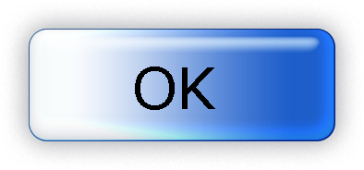




XAML: Declarative Programming for Windows
Markup for Windows
Build applications in simple declarative statements
Can be used for any CLR object hierarchy (not just WPF)
Code and content are separate
Streamline collaboration between designers and developers
Easy for tools to consume and generate
<Button Width="100">OK
<Button.Background>
LightBlue
</Button.Background>
</Button>
Button b1 = new Button();
b1.Content = "OK";
b1.Background = new SolidColorBrush (Colors.LightBlue);
b1.Width = 100;
Dim b1 As New Button
b1.Content = "OK"
b1.Background = New _ SolidColorBrush _ (Colors.LightBlue)
b1.Width = 100
Notes:
Context: Third Avalon pillar
Avalon introduces a new role to the rich client software development team – that of graphical designer. Gone are the days of boring gray buttons and poorly designed applications: with the declarative programming model enabled by XAML, you can split off presentation and logic in the same way as with a web application. XAML is a markup language that is inherently toolable, allowing for designers and developers to use independent tools.
From http://blogs.msdn.com/tims/archive/2004/11/19/267048.aspx:
XAML (which stands for "Extensible Application Markup Language") provides an XML-based way to specify declaratively a hierarchy of objects with properties and logic. We're positioning XAML as a user interface design language, because it is ideal for generating the kind of code that traditionally resided in a hidden #region area and was hard to maintain by both developers and tools. If you've ever wanted to edit the auto-generated blocks of code created by Visual Studio but been dissuaded by the warning comments writ large, or you've gone ahead regardless and been burnt badly when your tools refused to load your changes, you'll appreciate XAML. XAML is not Avalon, and Avalon is not XAML. It so happens that they come out of the same team at Microsoft, but they are not intrinsically wedded together. I've been asked before "where can I go to get the XSD for XAML?" and hopefully it's now clear that this question doesn't make much more sense than asking for the C# schema. XAML gets compiled into an object definition.

Slide 14
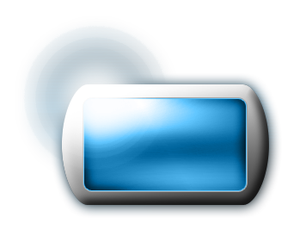


Controls, Templates, Styles & Resources, Layouts, Animation
Animation, Triggers, Timelines
<StackPanel>
<StackPanel.Triggers>
<EventTrigger RoutedEvent=“Button.Click">
<EventTrigger.Actions>
<BeginStoryboard>
<BeginStoryboard.Storyboard>
<Storyboard>
<ColorAnimation To="Yellow" Duration="0:0:0.5“
Storyboard.TargetName="TheBrush"
Storyboard.TargetProperty="Color" />
<DoubleAnimation To="45" Duration="0:0:2"
Storyboard.TargetName="LowerEllipseTransform"
Storyboard.TargetProperty="Angle" />
...
</StackPanel.Triggers>
… remainder of contents of StackPanel, including x:Name'd
TheBrush and LowerEllipseTransform …
</StackPanel>
Templated
Button
UI Services
Templates
Layout
Controls Library
Styles and Resources
Annotation
Notes:
Controls: WPF provides a rich set of controls – Border, BulletDecorator , Button, Canvas , CheckBox , ComboBox , ContextMenu , Control , DockPanel , DocumentViewer, Expander , FlowDocumentPageViewer , FlowDocumentReader , FlowDocumentScrollViewer , Frame , Grid , GridSplitter ,
GridView , GroupBox , Image , Label , ListView , ListBox , Menu , Panel , PasswordBox , Popup , Tooltip, etc….
Animation, Triggers and Timelines – In the illustration above, "Start" refers to an ellipse, MouseDown describes an event, and "Resume" describes the action that will be taken on the timeline "OnLoaded" when that event occurs. These 3 pieces make up a trigger. All this can be accomplished using a timeline, such as one shown above in Microsoft Expression Interactive Designer.
Styles and Resources – Styles centrally define the appearance and interactive behaviors of the elements in your app. A resource is an object defined within an application based on Microsoft® Windows® Presentation Foundation (WPF) for the purpose of re-using the resource in different places. One of the most common uses of a resource is in re-using a color in different controls. You can change the color of the resource once and see the changes affect any controls that linked to it. Changing one asset with multiple relationships is easier than replacing many instances of data that has been copied and pasted several times. Resources can be applied to any kind of value, such as text, numbers, styles, templates, and complex objects.
An external resource dictionary is a file that represents a set of resources. This file can be used in any project by linking to the resource dictionary from a scene or application. External resource dictionaries enable other applications to export re-usable assets which can then be imported into Microsoft Expression™ Interactive Designer. These external resource dictionary files allow designers and developers to re-use the same asset across multiple applications based on WPF.
Layout panels let you position elements within a window
Different layout panels
Canvas – for specifiying exact (x,y) positioning
DockPanel – for docking elements without worrying about exact (x,y) positioning
StackPanel – for stacking elements from left to right or from top to bottom
Grid – for row/grid positioning, while specifying column and row definitions
WrapPanel - models the right hand pane of an Explorer window, allowing you to handle items that flow over to a new row when the current row is full
14

Slide 15
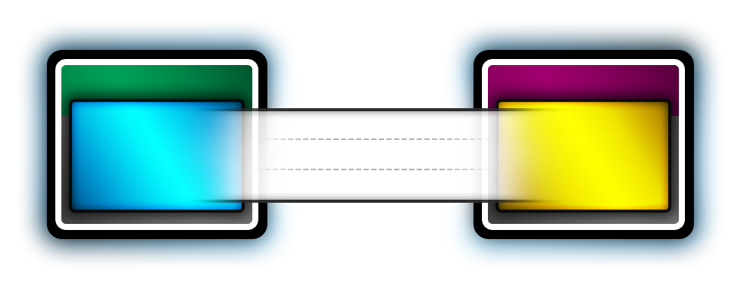
Data Binding
Binding Target
Binding Source
<StackPanel>
<Label>Select A Customer</Label>
<ListBox
Name="myListBox"
Background="HoneyDew"
ItemsSource= "{Binding {StaticResource mySource}}"
</ListBox>
</StackPanel>
Dependency Object
Object
Dependency Property
OneWay
TwoWay
Property
OneWayToSource
UI can be bound to CLR objects or XML
Dependency properties can also be bound to ADO.NET and objects associated with Web Services and Web properties
Sort, filter, and group views can be generated on top of the data
Data templates can be applied to data
Notes:
Data binding is the process that establishes a connection between the application UI and business logic. A typical use of data binding is to place server or local configuration data into forms or other UI controls. In Windows Presentation Foundation, this concept is expanded to include the binding of a broad range of properties to a variety of data sources. In WPF, dependency properties of elements can be bound to CLR objects (including ADO.NET objects or objects associated with Web Services and Web properties) and XML data.
Dependency properties are properties that are registered with the Windows Presentation Foundation (formerly code-named "Avalon") dependency property system. You can take advantage of the dependency property system in the following ways:
By backing your common language runtime (CLR) property with a dependency property. This allows your property to have support for styling, databinding, animation, initial default values, value expressions, property invalidations, or inheritance. Examples of dependency properties include the Background property and the FontSize property.
By creating attached properties. Attached properties are properties that can be set on any DependencyObject types. An example attached property is the Dock property.
OneWay binding causes changes to the source to automatically update the target, but changes to the target are not propagated back to the source. This type of binding is appropriate if the control being bound is implicitly read-only. For instance, you may bind to a source such as a stock ticker or perhaps your target property has no control interface provided for making changes, such as a data-bound background color of a table.
TwoWay binding causes changes to either the source or the target to automatically update the other. This type of binding is appropriate for forms or other fully interactive UI scenarios. Most properties default to OneWay binding, but some dependency properties (typically properties of user-editable controls such as the Text property of TextBox and the IsChecked property of CheckBox) default to TwoWay binding. A programmatic way to determine whether a dependency property binds one-way or two-way by default is to get the property metadata of the property using GetMetadata and then check the boolean value of the BindsTwoWayByDefault property.
OneWayToSource is the reverse of OneWay binding; it updates the source when the target changes.
15

Slide 16

Integrated Vector-based Graphics and Composition
Modern graphics capabilities
2D and 3D graphics
Image effects and codec
Hardware accelerated sub-pixel ClearType
Video and audio
Revolutionizing the graphics and media pipeline
Across the display, audio, printing, and remoting subsystems
Direct3D-based hardware acceleration throughout the rendering pipeline
Anticipates future hardware technologies
Resolution independence
Double floating point precision
Deeper color pipeline
Enabling high-quality, cinematic experiences
Notes:
Context: Second Avalon pillar
Avalon is about more than integration – it enables new scenarios that offer much richer graphical support. You can build really rich applications, such as the one you’ve just seen and the one you’re about to see – that would be very difficult to accomplish with GDI today.
Complex, good-looking 2D and 3D graphics are great to create with Avalon: it hits the sweet spot between the power of DirectX and the ease of use of WinForms. There’s support for image effects such as blur and shadow, sub-pixel ClearType improves still further on the typography support in GDI by allowing individual characters to be positioned with a sub-pixel origin: e.g. co-ordinates such as (10, 13 1/3). Video and audio support is integrated with the MIL (media integration layer) enabling seamless experiences that merge these things together.
The graphics and media pipelines are integrated across all subsystems. Graphics rendering is double buffered, using Direct3D and benefits from the hardware acceleration built into modern DirectX 9-compatible GPUs.
Lastly, graphics can scale up and down to high-dpi monitors or thumbnail shots of a window. Double FP precision means that you can calculate lengths and other units using floating-point rather than integer positioning only as was once the case, allowing for better scaling and accuracy, and deeper color pipelines allow for 32-bits per pixel with a full alpha channel.

Slide 17


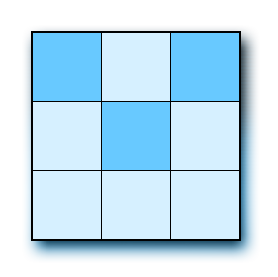
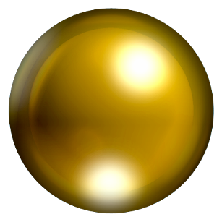

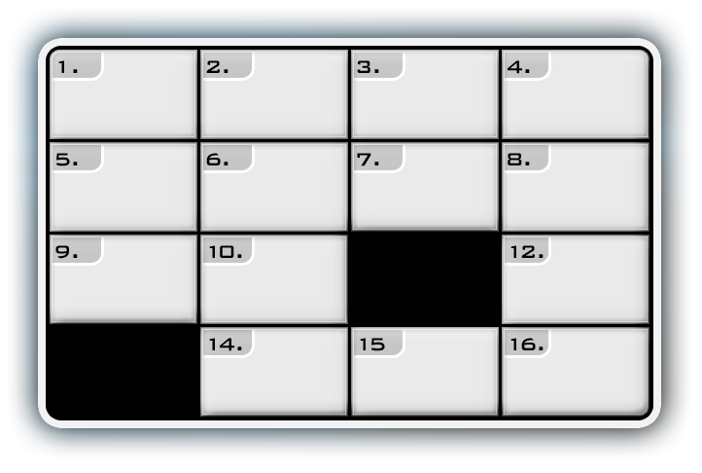

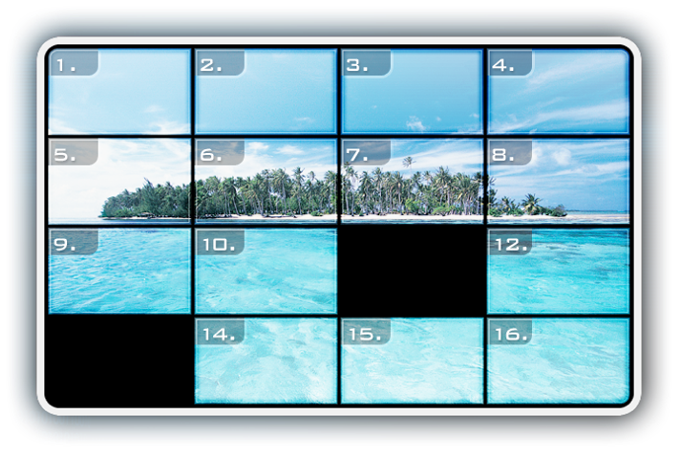
2D Graphics, 3D Graphics, Imaging
2D Graphics
Imaging
Notes:
Let’s look at the WPF support for 2D and 3D graphics, and imaging.
Graphics - The following areas comprise the Windows Presentation Foundation graphic APIs.
Brushes. Use the Brush classes to paint areas with solid colors, patterns, images, and drawings.
Shapes. Use Shape classes to create and render 2-D geometric shapes.
Imaging. Use the imaging classes to encode, manipulate, and displays bitmaps, and to apply special effects such as glow and blur to images and vectors.
Geometries. Geometries, like shape objects, represent 2-D shapes. Geometries are more versatile than shape objects, in that they can be used to define curves, clipping regions, and hit-testing areas. Unlike shape objects, geometries do not participate in the layout system and cannot draw themselves to the screen. They can be rendered using other framework elements, controls, visuals, or brushes.
Transformations. Use the Transform classes to rotate, translate, scale, and apply other 2-D effects to geometries, visuals, brushes, framework elements, and controls.
Animations. Use the animation and timing APIs to make objects change color, move, spin, grow, shrink, and more.
Visuals. Visual objects are the building blocks of the Windows Presentation Foundation rendering system. The visual layer is the Windows Presentation Foundation equivalent to GDI. All Windows Presentation Foundation objects use visuals to draw to the screen.
3-D Graphics - The System.Windows.Media.Media3D namespace defines 3-D graphics primitives, transformations, and animations that can be used to create 3-D controls and graphics.
Imaging Platform Basics
Not the mainstream WPF usage, but critical for a class of customers
Industrial strength, used extensively in the Windows Vista Shell
3rd party extensible bitmap CODEC architecture
Microsoft-supplied CODECs for JPEG, TIFF, PNG, GIF, BMP, ICO
Streams and NT Sections
Thumbnails in the Windows Vista shell
“Mainline” encode / decode, explicit imaging operations, etc.
Access through managed and native code
Imaging engine in Windows Vista, can be used by Win32
17

Slide 18
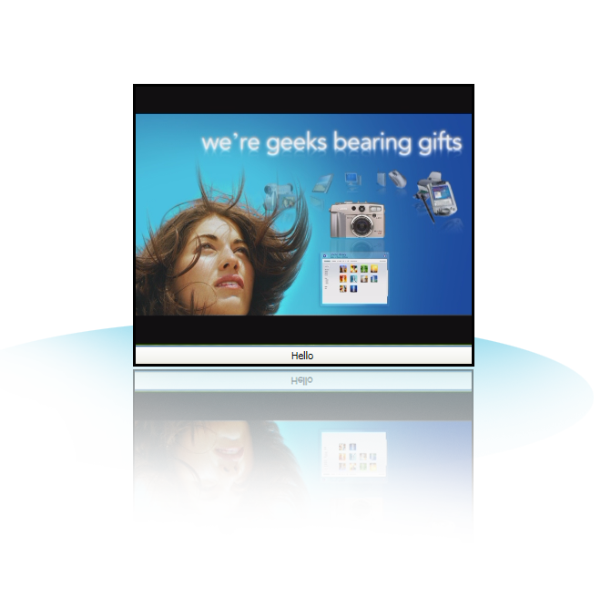
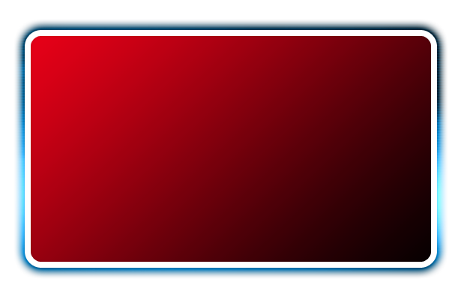
Audio & Video
<Border Width="400"
BorderBrush="Green"
BorderThickness="9">
<StackPanel>
<MediaElement Source="aero.wmv" />
<Button>Hello</Button>
</StackPanel>
</Border>
Formats: WMV, MPEG, Some AVIs
Can be synchronized with animations
Windows Media Foundation used to instantiate playback machinery into a DirectShow graph
Notes:
WPF supports the following audio/video formats.
Windows Media Video (.wmv) files are Advanced Systems Format (.asf) files that include audio, video, or both compressed with Windows Media Audio (WMA) and Windows Media Video (WMV) codecs.
MPEG (pronounced M-peg), which stands for Moving Picture Experts Group, is the name of family of standards used for coding audio-visual information (e.g., movies, video, music) in a digital compressed format. The major advantage of MPEG compared to other video and audio coding formats is that MPEG files are much smaller for the same quality. This is because MPEG uses very sophisticated compression techniques.
AVI, an acronym for Audio Video Interleave, is a multimedia container format introduced by Microsoft in November 1992, as part of the Video for Windows technology. AVI files contain both audio and video data in a standard container that allows simultaneous playback.
18

Slide 19
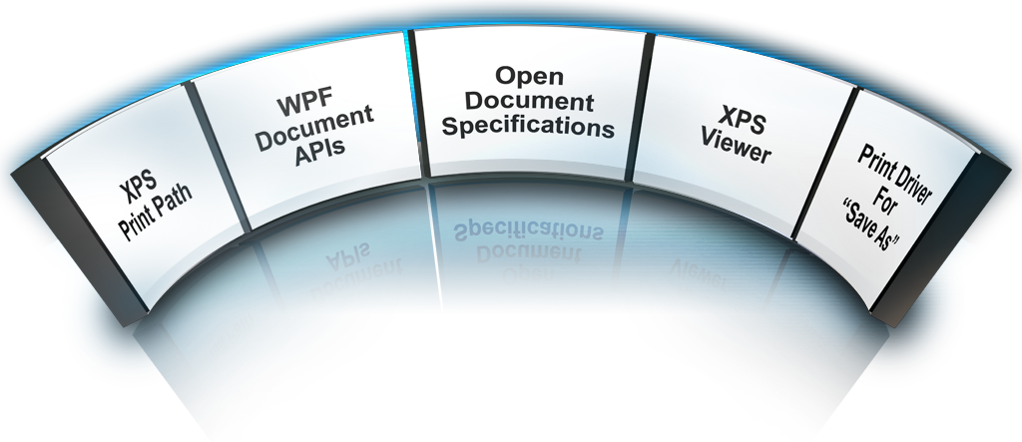
New Document Technologies
Notes:
19
Open Document Specifications
Open Packaging Conventions and XML Paper Specification (XPS) for use by devices and any application on any platform.
WPF Document APIs
Application programming interfaces (APIs) to manage package and content.
XPS Print Path
Print pipeline with XPS spool format and printer-page description language to speed and improve print job fidelity. New driver model.
Print Driver for “Save As”
A print-to-file converter for creating XPS Documents from any Microsoft Windows-based application.
XPS Viewer
A WPF utility that allow users to view, protect and print XPS Documents. Hosted in IE.

Slide 20
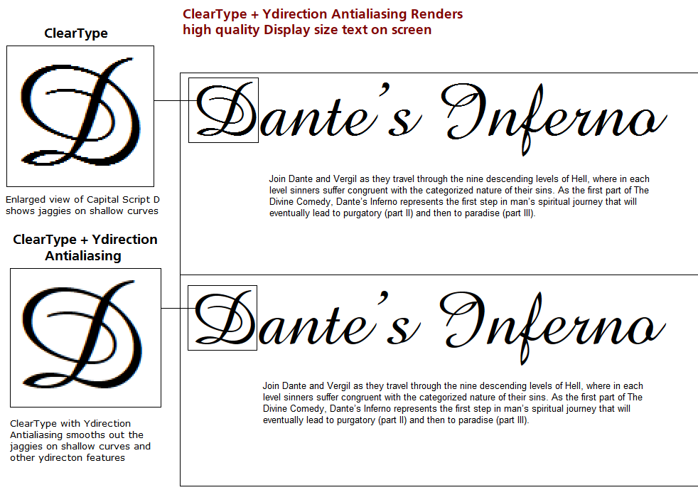
ClearType

Slide 21
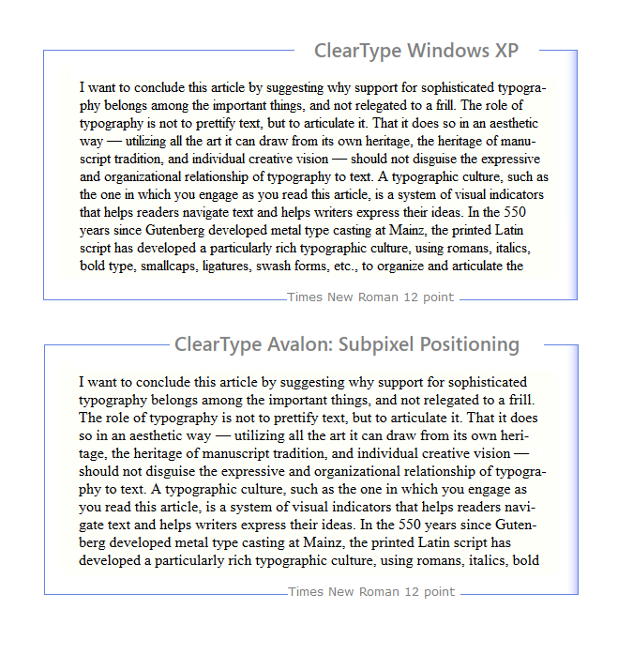
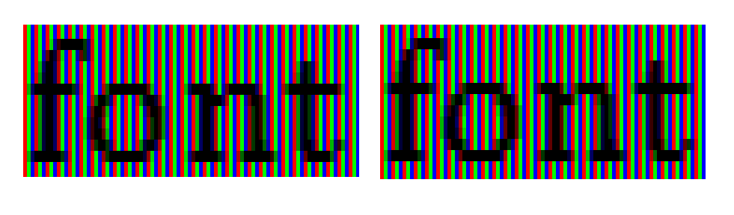
ClearType

Slide 22
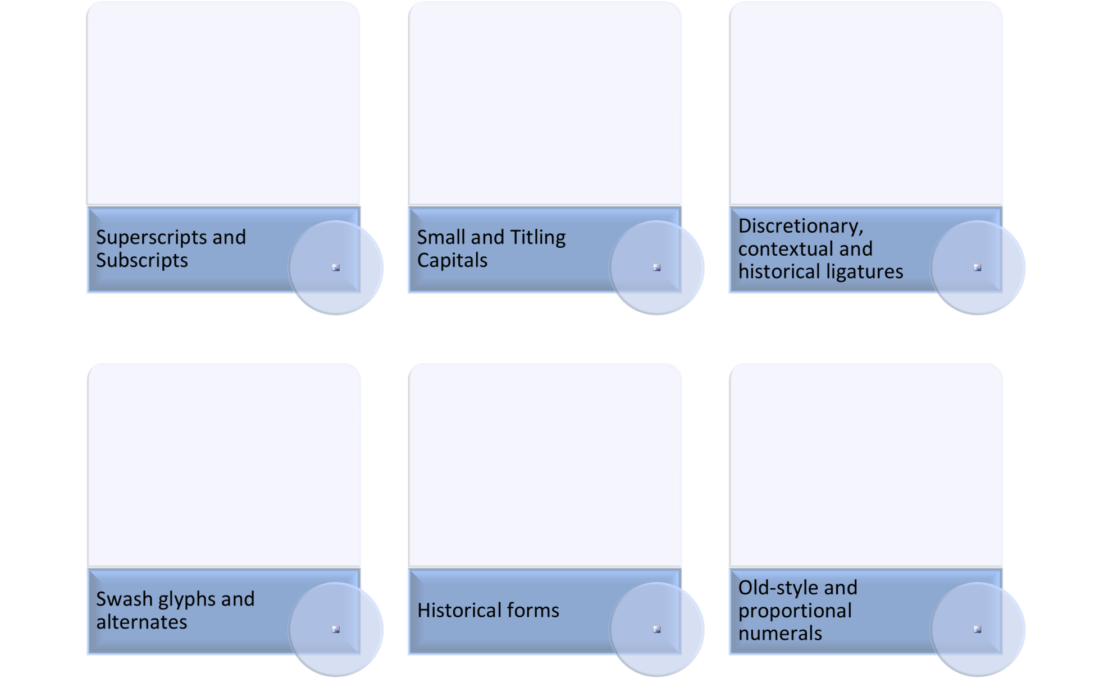
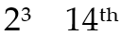
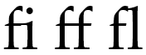

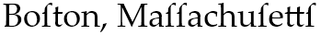
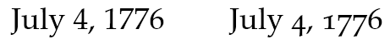
Typography

Slide 23
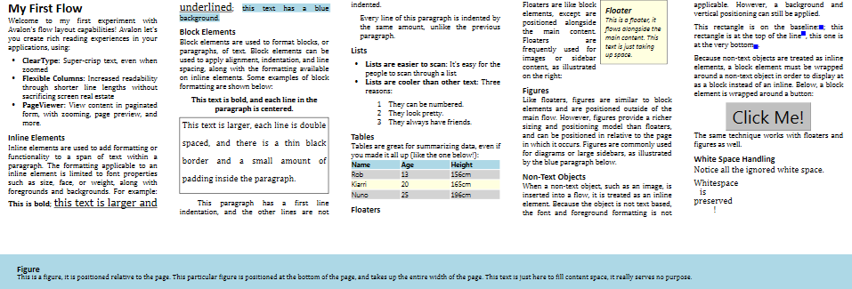
Flow Content
Block Elements
Paragraph
List
Table
Floater
Figure
Column
Inline Elements
Runs
Bold
Underline
Controls
Media
Hyperlinks
2D Graphics

Slide 24
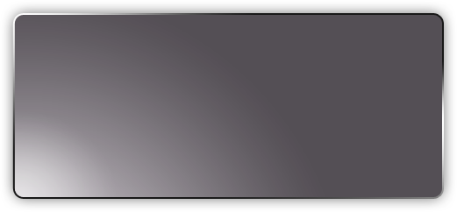
File Packaging Conventions
XPS Document Format
Office “12” Open XML Formats
Custom Formats
XML Paper Specification
Package Services
Parts and Relationships Abstraction
ZIP
Open Packaging Conventions Specification

Slide 25
Windows Presentation Foundation 3.5

Slide 26
Top 10 New Features in WPF 3.5
1. XBAP supported in Firefox
2. UIElement3D: host 2D controls in 3D space
3. Data bind to XLINQ data sources
4. Performance fixes to animation, layered windows, data binding
5. WCF available in partial-trust security mode
6. System.AddIn for isolation of pluggable components
7. Indic Script Support
8. More granular debugging of data binding failures
9. New properties for data validation
10. Native design-time developer tools integrated with Visual Studio 2008
Notes:
More information here: http://blogs.msdn.com/tims/archive/2007/07/27/what-s-new-in-wpf-3-5-here-s-fifteen-cool-features.aspx

Slide 27
WPF Resources
http://msdn.microsoft.com/windowsvista
MSDN Developer Center for Windows Vista / WPF
http://wpf.netfx3.com
Windows Presentation Foundation Technical Community
http://www.microsoft.com/expression
Microsoft Expression Studio
http://nibblestutorials.net
Designer-orientated tutorials for Expression Blend

Slide 28

© 2007 Microsoft Corporation. All rights reserved. Microsoft, Windows, Windows Vista and other product names are or may be registered trademarks and/or trademarks in the U.S. and/or other countries.
The information herein is for informational purposes only and represents the current view of Microsoft Corporation as of the date of this presentation. Because Microsoft must respond to changing market conditions, it should not be interpreted to be a commitment on the part of Microsoft, and Microsoft cannot guarantee the accuracy of any information provided after the date of this presentation. MICROSOFT MAKES NO WARRANTIES, EXPRESS, IMPLIED OR STATUTORY, AS TO THE INFORMATION IN THIS PRESENTATION.

